Slide 1
Welcome to WideWorld Importers
JP Voogt
@CloudySQL

Slide 2
Objective
We will cover what WideWorld Importers is
Why would you use this
What do you require to setup WideWorld Importers
How to setup WideWorld Importers OLAP
Create the WideWorld Importers Warehouse and load it
Run a load simulation
Sample Scripts

Slide 3
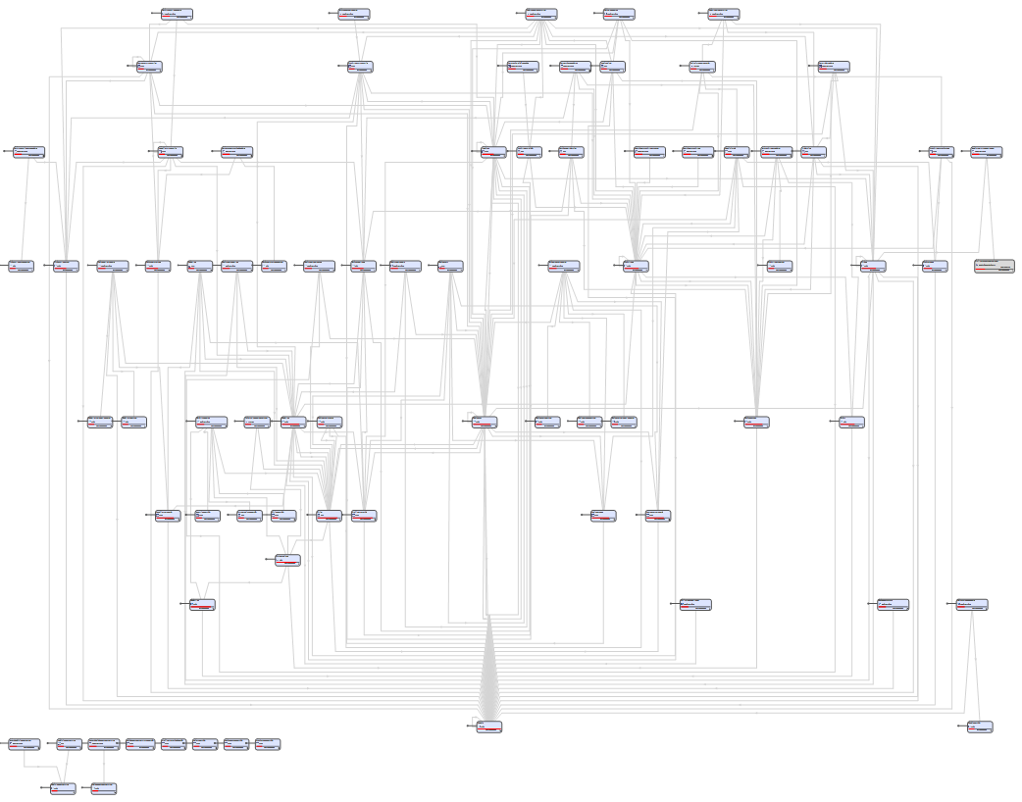
What is WideWorld Importers
a New sample Database that was developed for MS SQL 2016 featured

Slide 4
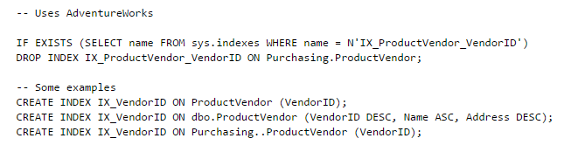
Why
AdventureWorks was outdated
A Replacement or re-Develop of AdventureWorks was needed to support and test the new features in MS SQL 2016
Books online code samples

Slide 5
Prerequisits
GitHub Account & Shell
Microsoft SQL Server 2016 (Preferably Developers Edition)
Visual Studio with Data Tools
Patience

Slide 6
How to Clone
Get Github Desktop/Shell (Dealers Choice)
Clone GIT Repo from shell
git clone https://github.com/Microsoft/sql-server-samples/tree/master/samples/databases/wide-world-importers

Slide 7
How to Build WideWorld Importers
~\wwi-database-scripts
Build DB
Create metadata
Build DB from metadata
Configure DB objects
Load data
Enable Full Features (Optional)
Create Backup (Optional)

Slide 8
Demo

Slide 9
How to Build the Data Warehouse
~\wwi-dw-database-scripts
Build DB
Create metadata
Build DB from metadata
Configure DB objects
Enable Full Features (Optional)
Create Backup (Optional)

Slide 10
Demo

Slide 11
Load Data Warehouse
~\wwi-integration-etl
Build SSIS package
Deploy to SSIS Catalog
Schedule Task

Slide 12
Demo

Slide 13
Run Workloads
Insert Vehicle Location Data
~\workload-drivers\vehicle-location-insert
Insert Orders
~\workload-drivers\order-insert

Slide 14
Demo

Slide 15
Sample Scripts
~\sample-scripts
Always Encrypted
In-Memory OLTP
Operational Analytics
Polybase
Row Level Security

Slide 16
Demo

Slide 17
Questions

Slide 18
Links
GIT Repo : https://github.com/Microsoft/sql-server-samples/tree/master/samples/databases/wide-world-importers
Demo DB History : https://blogs.msdn.microsoft.com/writingdata_services/2013/09/09/revisited-the-story-of-pubs-northwind-and-adventureworks/
Blog : http://www.sqlshack.com/new-sql-server-2016-sample-database/

